Slide 1


Slide 2
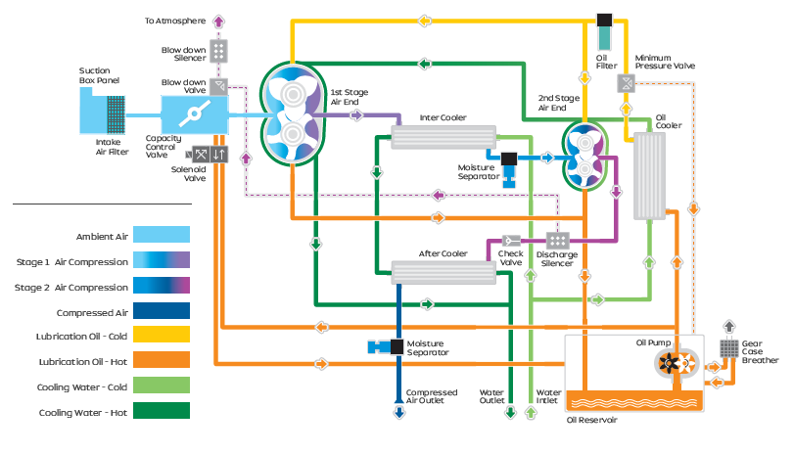
1
2
3
4
OFSAC Failure Symptoms – 70 % for failure can be detected | 1st Stage | 2nd Stage | System
 | High 1st stage outlet pressure | Low 2nd stage inlet pressure | High Discharge pressure
 |  | High 2nd stage inlet temperature | Low oil pressure
 |  | High 2nd stage outlet temperature | High oil pressure
 |  |  | High oil temperature
 | Other Symptoms |  | Low inlet water pressure
 | Pressure transmitter failure |  | High blow off pressure
 | VFD problem |  | High water inlet temperature
 |  |  | Pressure not building
 |  |  | Moisture in service line
 |  |  | Compressor not loading
 |  |  | Compressor not starting
1
2
3
4
Symptoms not considered
Common symptoms in EPSAC & OFSAC

Slide 3
Symptom : Pressure
Sl. No | Symptoms |  | PLC Setting |  | Operating Range | Input | Process | Output
 |  |  | Trip | Alarm
1 | High First Stage Outlet Pressure (FSOP) | * FSOP (All data in load condition) | 2.8 bar(g) | 2.6 bar(g) | 1.9 - 2.3 bar (g) | Prediction Limit: 0.2 bar(g) | 1.Calculate Median of First 24 hours FSOP after commissioning /servicing as Reference value#1 2.Calculate Previous day FSOP Median 3.Trigger output if Previous Day FSOP Median > (Reference value#1+ Prediction Limit) | Alert will be triggered and ticket will be raised in CCS/ CRM
 |  |  |  |  |  | Deterioration Limit:0.1 bar(g) | 1.Calculate Median of Previous week FSOP as Reference value#2 2.Calculate Previous day FSOP Median 3.Trigger output if Previous Day FSOP Median > (Reference value#2 + Deterioration Limit)
2 | Low Second Stage Inlet Pressure (SSIP) | * SSIP ( All data in load condition) | 1.5 bar(g) | 1.7 bar(g) | 1.9 - 2.2 bar (g) | Prediction Limit: 0.2 bar(g) | 1.Calculate Median of First 24 hours SSIP after commissioning /servicing as Reference value#1 2.Calculate Previous day SSIP Median 3.Trigger output if Previous Day SSIP Median < (Reference value#1- Prediction Limit)
 |  |  |  |  |  | Deterioration Limit:0.1 bar(g) | 1.Calculate Median of Previous week SSIP as Reference value#2 2.Calculate Previous day SSIP Median 3.Trigger output if Previous Day SSIP Median < (Reference value #2 - Deterioration Limit)
3 | High Blow off pressure (BOP) | * SSDT - Second stage Discharge temperature ( All data in Unload condition) | BOP : 0.4 bar(g) SSDT : 225ºC | BOP : NA SSDT : 220ºC | SSDT < 180ºC | Prediction Limit: 20ºC (Second Stage Discharge Temperature) | 1.Calculate Median of First 24 hours SSDT after commissioning /servicing as Reference value#1 2.Calculate Previous day SSDT Median 3.Trigger output if Previous Day SSDT Median > (Reference value#1+ Prediction Limit)
 |  |  |  |  |  | Deterioration Limit: 10ºC (Second Stage Discharge Temperature) | 1.Calculate Median of Previous week SSDT as Reference value#2 2.Calculate Previous day SSDT Median 3.Trigger output if Previous Day SSDT Median > (Reference value#2 + Deterioration Limit)
Note :
1. Daily Median shall be calculated based on the data from 00:00 Hrs 23:59 Hrs
2. Weekly median will be Median of Daily medians (Monday - Sunday)
3. Ambient temperature correction factor to be considered for improving the accuracy

Slide 4
Symptom : Pressure
Sl. No | Symptoms |  | PLC Setting |  | Operating Range | Input | Process | Output
 |  |  | Trip | Alarm
4 | Low Oil Pressure (OP) | * OP (All data in compressor running) | 1.1 bar(g) | 1.3 bar(g) | 1.5 – 2.2 bar (g) | Prediction Limit: 1.5 bar(g) | 1.Calculate Previous day OP Median 2.Trigger output if Previous Day Median OP < (Prediction Limit) | Alert will be triggered and ticket will be raised in CCS/CRM
 |  |  |  |  |  | Deterioration Limit: 0.2bar(g) | 1.Calculate Median of Previous week OP as Reference value#1 2.Calculate Previous day OP Median 3.Trigger output if Previous Day OP Median < (Reference value #1 - Deterioration Limit)
5 | High Oil Pressure (OP) | * OP (All data in compressor running) | 3.0 bar(g) | NA | 1.5 – 2.2 bar (g) | Prediction Limit: 2.2 bar(g) | 1.Calculate Previous day OP Median 2.Trigger output if Previous Day Median OP > (Prediction Limit)
 |  |  |  |  |  | Deterioration Limit: 0.2 bar(g) | 1.Calculate Median of Previous week OP as Reference value#1 2.Calculate Previous day OP Median 3.Trigger output if Previous Day OP Median > (Reference value #1 +Deterioration Limit)
6 | Low Water Inlet Pressure (WaterIP) | * WaterIP (All data in compressor running) | 1.0 bar(g) | 1.2 bar(g) | 2 – 3.5 bar (g) | Prediction Limit#1: 1.5 bar(g) | 1.Calculate Previous day WaterIP Median 2.Trigger output if Previous Day Median WaterIP < (Prediction Limit)
 |  |  |  |  |  | Deterioration Limit: 0.2 bar(g) | 1.Calculate Median of Previous week Water IP as Reference value#1 2.Calculate Previous day WaterIP Median 3.Trigger output if Previous Day WaterIP Median < (Reference value #1 - Deterioration Limit)
7 | High Water Inlet Pressure (WaterIP) | * WaterIP (All data in compressor running) | 4.0 bar(g) | NA | 2 – 3.5 bar (g) | Prediction Limit#1: 3.7 bar(g) | 1.Calculate Previous day Water IP Median 2.Trigger output if Previous Day Median WIP > ( Prediction Limit)
 |  |  |  |  |  | Deterioration Limit: 0.2 bar(g) | 1.Calculate Median of Previous week Water IP as Reference value#1 2.Calculate Previous day Water IP Median 3.Trigger output if Previous Day Water IP Median > (Reference value #1 + Deterioration Limit)
Note :
1. Daily Median shall be calculated based on the data from 00:00 Hrs 23:59 Hrs
2. Weekly median will be Median of Daily medians (Monday - Sunday)
3. Ambient temperature correction factor to be considered for improving the accuracy

Slide 5
Symptom : Pressure
Sl. No | Symptoms |  | PLC Setting |  | Operating Range | Input | Process | Output
 |  |  | Trip | Alarm
8 | High Discharge pressure (DP) | * DP (All data in compressor running) | Working Pressure + 0.5 bar(g) | NA | Working Pressure +0.2 bar (g) | Prediction Limit: 0.2 bar(g) | 1.Unload set pressure value in PLC as Reference value 2. Count if DP > (Reference value + Prediction Limit) 3.Trigger output if Count > 5 counts in a day | Alert will be triggered and ticket will be raised in CCS/ CRM
Note :
1. Daily Median shall be calculated based on the data from 00:00 Hrs 23:59 Hrs
2. Weekly median will be Median of Daily medians (Monday - Sunday)
3. Ambient temperature correction factor to be considered for improving the accuracy
4. The DP is a raw value, so proper filters need to be applied to avoid any transient values caused by noise

Slide 6
Symptom : Temperature
Sl. No | Symptoms |  | PLC Setting |  | Operating Range | Input | Process | Output
 |  |  | Trip | Alarm
9 | High Second stage Inlet Temperature (SSIT) | * SSIT - (All data in load condition) | 50ºC | 45ºC | < 36ºC | Prediction Limit: 5ºC | 1.Calculate Median of First 24 hours SSIT after commissioning /servicing as Reference value#1 2.Calculate Previous day SSIT Median 3.Trigger output if Previous Day Median SSIT > (Reference value#1+ Prediction Limit) | Alert will be triggered and ticket will be raised in CCS/ CRM
 |  |  |  |  |  | Deterioration Limit: 3ºC | 1.Calculate Median of Previous two days SSIT as Reference value#2 2.Calculate Previous day SSIT Median 3.Trigger output if Previous Day SSIT Median > (Reference value#2 + Deterioration Limit)
10 | High Second stage Outlet Temperature (SSDT) | * SSDT - (All data in load condition) | 225ºC | 220ºC | < 195ºC @ 8.8 bar (g) | Prediction Limit: 20ºC | 1.Calculate Median of First 24 hours SSDT after commissioning /servicing as Reference value#1 2.Calculate Previous day SSDT Median 3.Trigger output if Previous Day Median SSIT > (Reference value#1+ Prediction Limit)
 |  |  |  |  |  | Deterioration Limit: 10ºC | 1.Calculate Median of Previous two days SSDT as Reference value#2 2.Calculate Previous day SSDT Median 3.Trigger output if Previous Day SSDT Median > (Reference value#2 + Deterioration Limit)
11 | High Oil Temperature (OT) | * OT - (All data in running condition) | Mineral Oil : 55ºC Synthetic Oil : 75ºC | Mineral Oil : 50ºC Synthetic Oil : 70ºC | Mineral Oil : 40ºC Synthetic Oil : 40ºC | Prediction Limit: 10ºC | 1.Calculate Median of First 24 hours OT after commissioning /servicing as Reference value#1 2.Calculate Previous day OT Median 3.Trigger output if Previous Day Median OT > (Reference value#1+ Prediction Limit)
 |  |  |  |  |  | Deterioration Limit: 5ºC | 1.Calculate Median of Previous two days OT as Reference value#2 2.Calculate Previous day OT Median 3.Trigger output if Previous Day OT Median > (Reference value#2 +Deterioration Limit)
Note :
1. Daily Median shall be calculated based on the data from 00:00 Hrs 23:59 Hrs
2. Weekly median will be Median of Daily medians (Monday - Sunday)
3. Ambient temperature correction factor to be considered for improving the accuracy

Slide 7
Further Action
Pressure not building (Same Rule as EPSAC)
Moisture in service line
Compressor not loading
Compressor not starting
Air cooled models
Low pressure models

Slide 8
Thank You

Slide 9
